Slide 1
Python Helpdesk
A way to start a successful career

Slide 2
PRESENTATION DONE BY
G.PREETHAM-AP21110010793
KKV.DAYAKAR-AP21110010788
G.NAGA VISHNU-AP21110010845
M.NITHIN-AP21110010833

Slide 3

Introduction:
This project helps the user to give a detailed explanation on python methods and their functions to the user.
The helpdesk helps the user to understand the basic methods and syntax which enhances the user to get a detailed explanation on topic without any confusion.
As python is dynamically programmed the user even understands the code and implement the codes to increase the flexibility of code.

Slide 4
Implementation of code
1.We implemented the program using basic explanation user understand the
Program efficiently and try to implement the code by himself.
2.In the program we added the topics which are essential to build the foundation for python programming.
3.Along with the above things we also included the errors(limitations).
4.The common functions are also given in the program. Which are common in some methods.
5.The next topic we added in the program is OOP’S concepts. Which are basically inherited from cpp programming.
6.We added the syntaxes for the topics which gives basic idea to the user. Where, the user implements the syntax in program.
7.The string uses to check which number is user entered. If the user enter the valid number it goes to next string, else, it gives the else statement.

Slide 5
So, here we have to enter a number between 1 to 10 and on entering a number in the given range , program provides the following-
If n==1: It gives List methods
If n==2: It gives String methods
If n==3: it gives Tuple methods
If n==4: it gives set methods
If n==5: it gives Dictionary methods
If n==6: it gives Files methods
If n==7: it gives Keywords
If n==8: it gives Exceptions
If n==9: it gives OOP’S concepts
If n==10: it gives common methods
Here after user gets the called input

Slide 6
if(n==1):
print("List is a collection which is ordered and changeable. Allows duplicate members.") print("List1=[append,clear,copy,extend,insert,pop,remove,reverse,sort]")
stnr=str(input("Enter any keyword:"))
if stnr=="append":
print("It Adds an element at the end of the list.\nAppend takes one argument.") print("Syntax:\nList.append(new item)")
elif stnr=="clear":
print("Removes all the elements from the list.\nClear takes no arguments.")
print("Syntax:\nList.clear()")
elif stnr=="copy":
print("Returns a copy of the list.\nCopy takes no arguments.")
print("Syntax:\nNewlist=oldlist.copy()")
elif stnr=="extend":
print("Add the elements of a list (or any iterable), to the end of the current list.\nExtend takes one argument.")
print("Syntax:\nlist1.extend(list2)")

Slide 7
elif stnr=="insert":
print("Adds an element at the specified position.\nInsert takes two arguments.")
print("Syntax:\nlist.insert(1,newitem).\nWhere 1 specifies the position for which u add the element.")
elif stnr=="pop":
print("Removes the element at the specified position.\nPop takes one argument.")
print("Syntax:\nlist.pop(1)\nWhere 1 specifies the position for which u want to remove the element.")
elif stnr=="remove":
print("Removes the item with the specified value.\nRemove takes one argument.") print("Syntax:\nlist.remove(item in list)")
elif stnr=="reverse":
print("Reverses the order of the list.\nReverse takes one positional argument.") print("Syntax:\nlist.sort(reverse = True)\nTrue,False are postional arguments.")
elif stnr=="sort":
print("Sorts the list ascending by default.\nSort takes no positional arguments.") print("Syntax:\nlist.sort()\nThe sorting is done in alphabetical order.")
else:
print("IT is not a list keyword or method or it is a common function.\nFor common functions enter number 10.\U0001F621\U0001F621\U0001F621")

Slide 8
Our source code contains:
Definition of the method
The different functions of the method
Defining Parameters of the method(including optional)
Syntax of the function
Use of the function
From our source code, we can see that by entering n==1,the code is giving definition of the method, it's function, use of the function, syntax of the function.
i.e., this is common for all methods in program(till n==10).the code returns the same details about each method as per the program.
If the user enter other than 1 to 10,then it directly executes the else statement and complete the code execution.
The else statement also works if the user enters different methods in the second string, then it calls else statement.

Slide 9
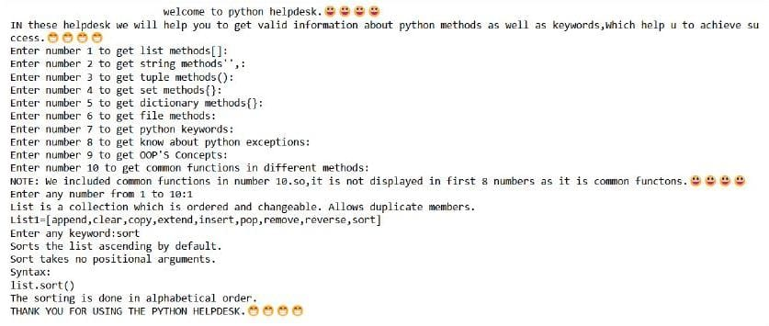

Slide 10


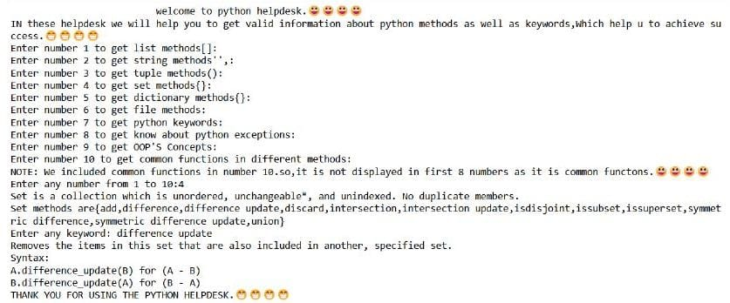




Slide 11
REMARKS:
Space complexity of code is little high.
Files method is not used.
Loops are not used.
Goto method is not used.so,it gives only unique output (of output based on the particular user input) per execution.
It is time consuming language , it has a low execution speed.
BENEFITS:
Easy to learn.
Code is Highly compatible.
Flexible to use.
The helpdesk increases python productivity.
Code reusability and readability.

Slide 12
THANK
YOU

